Slide 1
Module 3 Cryptographic Mechanisms in Windows
Section 2 – Hardware-Based Cryptography
June 2018

Slide 2
.
Part 1 – Smartcard API
Learning Objectives

Slide 3
Why Smartcards ?
Smartcards provide a second authentication
Smartcards are safer because authentication relies on something you have (the card) and something you know (the PIN code)
One of the foundation of Smartcards is the inability to clone them
That’s called : 2-form authentication

Slide 4
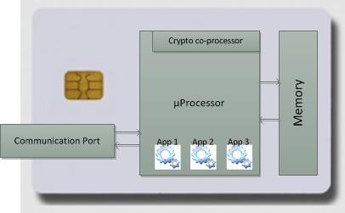
Smartcards
SmartCards can embed applications
Memory is only accessible through an application
Host cannot access memory directly

Slide 5
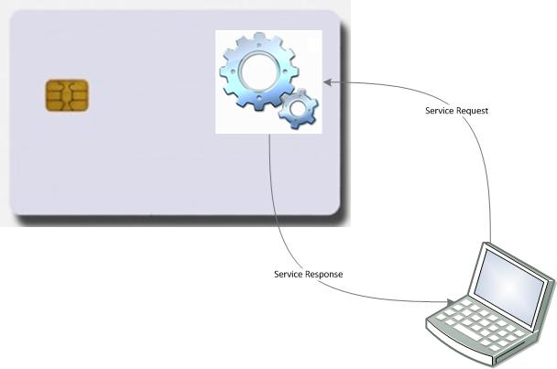
Smartcards
Smartcard concept can also be understood as a lightweight portative server
You access services hosted into the card through a communication protocol
Protocols are specific to cards manufacturers

Slide 6
Smartcards
The nature of Smartcards make them pretty good stores for cryptographic private keys
In most cases, certificates and private keys are not stored in the same memory. Private keys are stored in dedicated slots or key containers.
Key containers are dedicated to store private keys. They exist in finite number and are characterized by cryptographic properties
To link with previous slide, cryptographic operations are one of the apps the card embed when leaving the card factory

Slide 7
PIN Codes
There are many kinds of PIN – Personal Identification Number codes
PIN codes are used to protect the card from unauthorized access
After a given number of wrong PIN attempts, the PIN is locked
Mostly two categories
User PIN (or just PIN code)
Admin Code (or PUK)

Slide 8
PIN Codes
User PIN protects private keys
=> To access private key, you must know the PIN
Admin Code is a “super” code for administrative tasks like:
User PIN unlock or definition
Card formatting
Take precautions when typing the Admin Code or PUK. This code cannot be unlocked, even by the manufacturer.

Slide 9
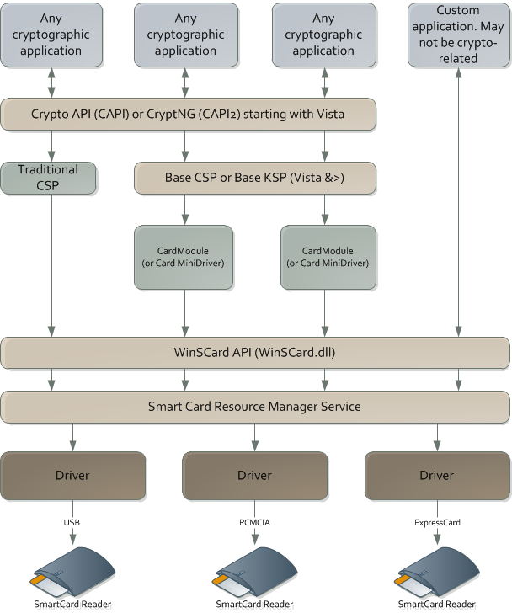

Applications accessing smartcards
Applications usually access smartcard cryptographic functions through CAPI or CryptNG using a dedicated CSP/KSP
But, special applications can communicate with the card directly without going through the Windows cryptographic APIs

Slide 10
Smartcard Resource Manager Service
Service name : SCardSvr
Windows XP : SCardSrv.Exe
Windows Vista & + : SVCHost
Manages access to Smartcards
Keeps a cache between certificates and Smartcards
Starting with Vista, self registers for PnP events
A DeviceID is generated base on card ATR that allows automatic CardModule download through WindowsUpdate
See http://technet.microsoft.com/en-us/library/ff404284(WS.10).aspx

Slide 11
Smartcard Registry entries
Configuration stored in HKEY_LOCAL_MACHINE\SOFTWARE\Microsoft\Cryptography\Calais
Calais\Cache => Cache of the Smartcard resource manager service. The reg value can be deleted to clear the cache but you will have to restart the service after deletion.
Calais\Readers => list of readers that are currently present on the machine or that were previously connected to the machine. It can contain disconnected readers so, it’s a kind of cache. The reg key can be deleted to clear the history, but you will have to restart the service to rebuild the list.
Calais\SmartCards => mapping between Smartcard families and CSP or CardModules. For each Smartcard family, there must be an ATR and ATRMask values. They are all of type REG_BINARY. They serve to recognize a Smartcard.

Slide 12
Smartcard in Remote Desktop Services
Allows RDS Sessions to access local Smartcards through RDP
RDP encapsulate Smartcard protocol and doesn’t deal with its content. That means:
On the client, install reader drivers
On the TS host, install necessary applications and card middleware
The most common usage is Smartcard logon through RDS

Slide 13
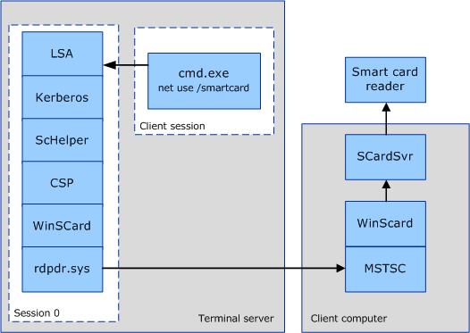
Smartcard RDP redirection stack
The client Smartcard API (WinSCard) detects the session is remote
It uses rdpdr.sys to send smartcard data packets to the client computer
On the client computer, the RDP client application (mstsc.exe) just forwards the data to the regular Smartcard stack on the client machine

Slide 14
Smartcard certificate propagation service
This service copies certificate present on the Smartcard in the user’s Personal store
Accesses only certificate. Not private keys
It must be enabled and started for other application to access Smartcard certificates
Windows Vista & + : CertPropSvc
GPO Settings:
Turn on certificate propagation from smart card
Configure root certificate clean up
Turn on root certificate propagation from smart card
See http://technet.microsoft.com/en-us/library/ff404287(WS.10).aspx

Slide 15
Smart Card Removal Policy Service
Tells the system what to do when the Smartcard is removed from the reader
Must be enabled and started if customer wants to lock the station when removing Smartcard
Windows Vista & + : ScPolicySvc
GPO Setting : Security Options\Interactive logon: Smart card removal behavior
See http://technet.microsoft.com/en-us/library/ff404287(WS.10).aspx

Slide 16
Windows SmartCard logon before Vista
Not an easy process:
A smart card could support only one certificate for logon.
Only one container on the smart card could be used : the default container
Changing the PIN and unblocking a smart card were not natively supported nor integrated
Multiple constraints on certificates that may prevent using external or public certificates for SmartCard logons

Slide 17
Windows SmartCard logon before Vista
Certificate must have the following EKU:
Smart Card Logon (1.3.6.1.4.1.311.20.2.2)
Client Authenticaion (1.3.6.1.5.5.7.3.2)
Certificate must have Digital Signature bit set in Key Usage extension
Certificate must have a Key Exchange private key
Certificate must include a CRL distribution point attribute
Certificate must contain the user principal name (UPN) in the subject alternate name extension
Private key must reside in the default slot of the card
See kb 281245 for details

Slide 18
Windows Smartcard logon compared
Pre-Windows Vista
Windows Vista and >
Certificate requirement
SmartCard logon EKU
Client authentication EKU
Digital Signature bit set in Key Usage
CRL distribution point
Must include UPN in SAN
Card Requirement
Private Key stored in default slot
Private Key must be for Key Exchange
Certificate requirement
EKU is optional but if specified, must include SmartCard logon
CRL distribution point extension is optional but if specified, must be valid
Digital Signature bit set in Key Usage
SAN may not embed UPN. If so, explicit mapping is required.
Card Requirement
Any slot can be used
Any key type allowed

Slide 19
Windows smartcard logon after Windows Vista
Most of the flexibility features of SmartCard logon are only available with help of new GPO settings
Computer Configuration\Administrative Templates\Windows Components\Smart Card
See http://technet.microsoft.com/en-us/library/ff404287(WS.10).aspx

Slide 20
Require Smartcard for logon
Two settings set the Smartcard mandatory for user logon
User attribute “Smart card is required for interactive logon”. If enabled then:
The user password is immediately set with a random value
All Kerberos authentications will now necessitate a Smartcard
NTLM authentications are still available but as the password was set with a random value, NTLM is somewhat disabled for the user. You must set a new password by hand if you still want NTLM to work.
Machine security setting “Interactive logon : Require smart card”. If enabled then:
Interactive logons (local console or remote desktop services) on the machines targeted by the GPO must be done with a Smartcard for all users
All other types of logon (Network logon, service logon, batch logon) can still use a password.

Slide 21
Dumping smartcard information using certutil.exe
Certutil -v -SCInfo -urlfetch
Accesses the Smartcard resource manager service
Lists readers, readers status, cards, cards ATR and card CSP
Tries to test the private key
Extracts the certificate chain
Verifies certificate revocation
Verifies AIA and CDP reachability
Dumps all the certificates

Slide 22
Smartcard API
SCardEstablishContext : Establishes a resource manager context for accessing the smart card database.
SCardConnect : Establishes a connection between the calling application and a smart card.
SCardTransmit : Sends a service request to a smart card.
SCardReleaseContext : Closes an established resource manager context.
SCardGetStatusChange : Blocks execution until status of the readers changes.
Full list : https://msdn.microsoft.com/en-us/library/windows/desktop/aa374731(v=vs.85).aspx#smart_card_functions

Slide 23
BaseCSP specifications
Used by card manufacturers to design their card module for BaseCSP or BaseKSP
https://docs.microsoft.com/en-us/previous-versions/windows/hardware/design/dn631754(v=vs.85)

Slide 24
PIN caching with BaseCSP/KSP
The PIN cache protects the user from entering a PIN every time the smart card is unauthenticated.
The problem
After a smart card is authenticated, it will not differentiate among host-side applications—any application can access private data on the smart card.
To mitigate this, the smart card enters an exclusive state when an application authenticates to the smart card.
However, this means that other applications cannot communicate with the smart card and will be blocked. Therefore, such exclusive connections are minimized.
This is where the PIN cache is used to minimize exclusive use of the smart card without forcing the user to enter a PIN multiple times.

Slide 25
PIN caching process
The Base CSP internally maintains a per-process cache of the PIN. The PIN is encrypted and stored in memory. The functions that are used to secure the PIN are RtlEncryptMemory, RtlDecryptMemory, and RtlSecureZeroMemory, which will empty buffers that contained the PIN.
Cards can mark their PIN as not cachable

Slide 26
.
Part 2 – Trusted Platform Module
Learning Objectives

Slide 27
Trusted Platform Module
Trusted Platform Module (TPM) is an international standard for a secure cryptoprocessor, which is a dedicated microprocessor designed to secure hardware by integrating cryptographic keys into devices.
TPM's technical specification was written by a computer industry consortium called Trusted Computing Group (TCG).
International Organization for Standardization (ISO) and International Electrotechnical Commission (IEC) standardized the specification as ISO/IEC 11889 in 2009.

Slide 28
Trusted Platform Module
Can be hardware (also called discrete TPM) or software
TPM does not store the certificates or keys
Keys are either imported into it or created by the TPM
Keys are then protected by the TPM so that only that chip can read the material
The protected object is then transfered back to the operating system
TPM never release sensitive parts of the keys it has generated
TPM allows keys to be protected by various authorization mechanisms

Slide 29
Comparing Trusted Module Platform revisions
Version 1.2 used to be deployed widely. Version 2.0 mostly supersedes it and should be preferred
Major differences
TPM 1.2 is constrained by its data structures to using RSA and SHA. TPM 2.0 allows variability of underlying algorithms
TPM 1.2 has different schemes to allow access, manipulation of objects. TPM 2.0 provides a uniform framework for authorization capabilities so they may be combined
TPM 2.0 offers new authorization mechanisms like clear text passwords and HMAC
TPM 2.0 adds storage hierarchy controlled by firmware (or BIOS)

Slide 30
TPM 2.0 Architecture
I/O Communication Port
Key Generation
Hash Engines
Random Number Generator
Symmetric Engines
Power Detection
Management
Execution Engine
Non-Volatile Memory
Volatile Memory
Asymmetric Engines
Power Detection
Manages power transitions in conjunction with platform power states
TPM NV memory contains Shielded Locations which can only be accessed with Protected Capabilities.
Volatile Memory
PCR – Platform Configuration Registers
Session Store
Object Store

Slide 31
CRTM and Trust
CRTM – Core Root of Trust for Measurement
CRTM is the first code executed by the machine. It is basically a firmware we trust.
Concept of trust chaining
Trusted platform will expand its trust boundary by verifying next boot stage before transferring control. This is achieved by
Code measurement: code is hashed and compared with trusted values
Code signing : identity of the code is known and compared with trusted values

Slide 32
Roots of trust
These are system elements that must be trusted because misbehavior is not detectable
Requires three Roots of Trust in a trusted platform:
Root of Trust for Measurement (RTM)
RTM sends measurements to the RTS.
Usually, RTM is the CPU executing the CRTM code
Root of Trust for Storage (RTS)
Shielded memory area of the TPM. Can only be accessed by the TPM’s internal components
Root of Trust for Reporting (RTR)
Securely attests the state of the system.
RTR is usually a digitally signed digest of selected TPM values (registers)

Slide 33
Basic Trusted Platform Features
Apart from common cryptographic routines, TPM and associated platform provide some important features on top of which many security features sit :
Attestations
Attestation Key Identity Certification
Protected Location
Integrity Measurment and Reporting

Slide 34
Attestations
Endorsement Certificate
TPM embeds an asymmetric key pair called EK - Endorsement Key. Endorsement certificate is issued by TPM manufacturer and proves that the TPM complies with the specification.
Platform Certificate
A certificate issued by a platform manufacturer which testifies it contains a TPM, a CRTM and a trusted path between TPM and RTM
Attestation Key Certificate
Issued by an external entity
Proves that a specific key is protected by a genuine TPM
Key Attestation
Proves that a key is protected by a TPM.
Takes the form of a signature from the TPM using an AK – Attestation Key protected by the TPM and certified by a Key Attestation Certificate
Quote
Attests to a measurement to vouch that a particular software/firmware state exists on a platform.
Takes the form of the signature of internal TPM register with an attestation key

Slide 35
Attestation Key Identity Certification
Any TPM user that can create a key on a TPM and can create a restricted-use signing key.
The key creator may then ask a third party, such as an attestation Certificate Authority (CA), to provide a certificate for it.
The attestation CA may request that the caller provide some evidence that the key being certified is a TPM-resident key.
Evidence of TPM residency may be provided using a previously generated certificate for another key on the same TPM. An EK or Platform Certificate may provide this evidence.

Slide 36
Protected Location
When the sensitive portion of an object is not held in a Shielded Location on the TPM, it is encrypted.
When encrypted, but not on the TPM, it is not protected from deletion, but it is protected from disclosure of its sensitive portions.
Wherever it is stored, it is in a Protected Location.
Objects in long-term protected storage need to be loaded into the TPM for use.
The application that created the objects manages their movement from long-term storage to the TPM.
Encryption of Protected Locations uses multiple seeds and keys that never leave the TPM.

Slide 37
Integrity measurement and reporting
An integrity measurement is a value that represents a possible change in the trust state of the platform. The measured object may be anything of meaning but is often
a data value
the hash of code or data
an indication of the signer of some code or data
The RTM makes these measurements and records them in RTS (in registers called PCR) using Extend operation.
The Extend process allows the TPM to accumulate an indefinite number of measurements in a relatively small amount of memory.
Extend operation consists in hashing current PCR value with new data and overwriting the PCR value: PCR_new = HASH(PCR_old + new_data) Effectively creating hash chain with no storage of previous values.

Slide 38
TPM Control
3 entities controls the TPM
Platform (usually, the firmware of the platform)
Owner (usually, the operating system)
Privacy Administrator
The Owner and Privacy Administrator are often the same entity.
For Each entity, TPM stores
An authorization value (platformAuth, ownerAuth and endorsmentAuth)
An authorization policy (platformPolicy, ownerPolicy and endorsementPolicy)
A seed (PPS – Platform Primary Seed, SPS – Storage Primary Seed, EPS – Endorsement Primary Seed)

Slide 39
TPM Control
Platform Controls
The platform firmware has overall control of the TPM and the availability of the TPM to the platform Owner or Privacy Administrator.
Can allocate NV memory
PCR configuration
Control availability of storage hierarchies
Change PPS, SPS and EPS
Owner Controls
Can allocate NV memory
Control availability of storage hierarchies
Privacy Administrator Controls
Controls the Endorsement Hierarchy

Slide 40
Lockout Control
A TPM is required to implement a lockout mechanism to protect against so-called “dictionary attacks”
where an attacker tries numerous authorization values until one succeeds.
When the dictionary attack lockout is engaged, preventing use of some resources, it is helpful to have a secret value that resets lockout.
TPM stores:
Lockout secret value (lockoutAuth)
Optional lockout policy (lockoutPolicy)

Slide 41
TPM Ownership
Before making use of the TPM, it must be owned
Taking ownership of a TPM is the process of inserting authorization values for the ownerAuth, endorsementAuth, and lockoutAuth.
Starting with Windows 8, Windows automatically tries to take ownership of the TPM at boot.
Creates values for the 3 authorization
OwnerAuth may be stored in registry. By default it is not.

Slide 42
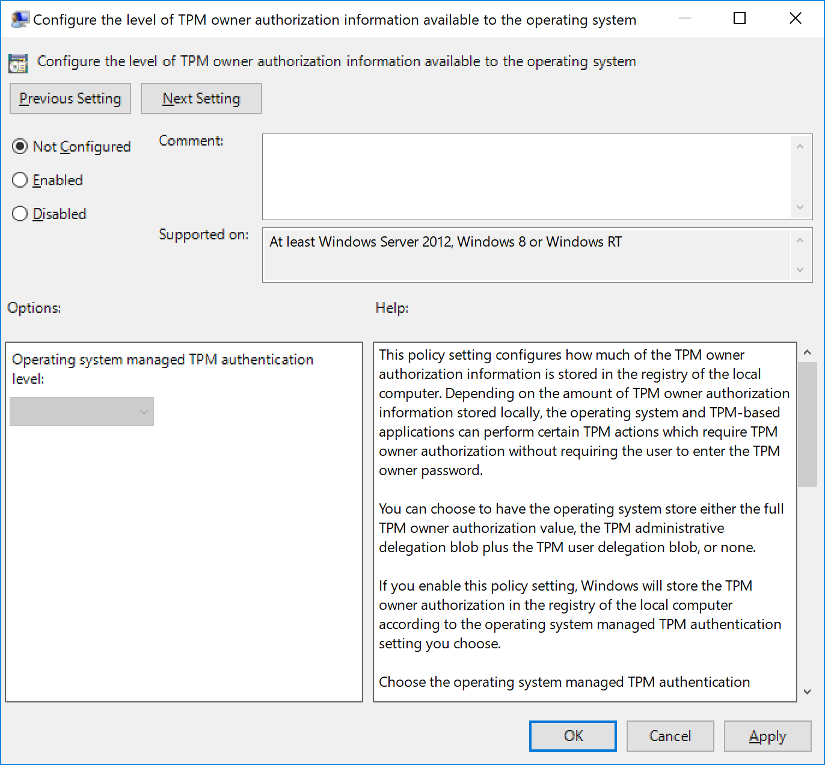
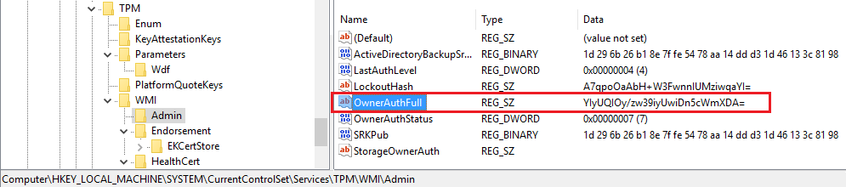
Storing OwnerAuth value in registry
When GPO is configured to Full, ownerAuth will be stored as “OwnerAuthFull” in the registry:
HKEY_LOCAL_MACHINE\SYSTEM\CurrentControlSet\Services\TPM\WMI\Admin
When GPO is configured to Delegated or None, TPM ownerAuth is not stored

Slide 43
Clearing the TPM
TPM Clear operation instructs the TPM to:
flush any transient or persistent objects associated with the SPS or EPS hierarchies (PPS objects are not affected);
Enable Storage Hierarchy and Endorsement Hierarchy
set ownerAuth, endorsementAuth, and lockoutAuth to empty
set ownerPolicy, endorsementPolicy, and lockoutPolicy to empty
replace the existing SPS with a new value from the RNG

Slide 44
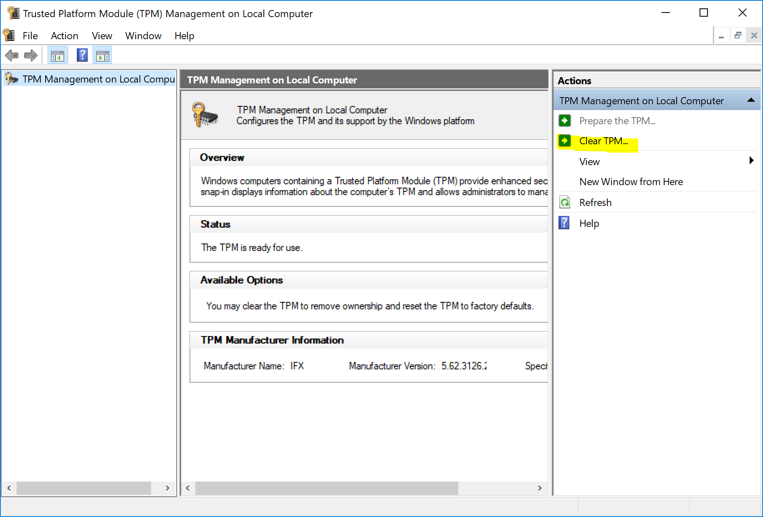
Clearing the TPM from Windows
TPM.msc console

Slide 45
Storage Hierarchies
The TPM uses hierarchies of Protected Locations.
A hierarchy is constructed with Storage Keys as the connectors to which other types of objects (keys, data, and other connectors) may be attached.
A hierarchy is rooted in a secret seed key, kept in the TPM. To create a hierarchy of keys, the seed key (Primary Seed) is used to generate a key that uses a specific set of algorithms.
When an Object is created, the keys used for protection of the Object’s sensitive area are derived from a seed value (seedValue) in the sensitive area of the Storage Key.

Slide 46
Protected Storage hierarchies
Storage Primary Seed
Primary Seed helps creating the hierarchy’s root key
To protect an object, a new storage key is created from a seed
The seed is encrypted by the parent storage key
Storage Root Key
Seed
Storage Key A
Storage Key B
Seed
Storage Key C

Slide 47
.
Part 3 – Windows Hello for Business
Learning Objectives

Slide 48
Windows Hello & Hello for Business naming history
What was once called Next Generation Credentials
Was then called Microsoft Passport and Microsoft Passport for Work
But is now called Windows Hello and Windows Hello for Business

Slide 49
Windows Hello vs. Windows Hello for Business
Windows Hello : Modern way for users to unlock and sign in using a PIN or some gestures
This use of Hello provides a layer of protection by being unique to the device on which it is set up.
Windows Hello for Business: Windows Hello + Ability to provision an user key or a certificate for authentication

Slide 50
Addressing problems
Windows Hello for Business addresses the following problems with passwords:
Passwords can be difficult to remember, and users often reuse passwords on multiple sites.
Server breaches can expose symmetric network credentials.
Passwords can be subject to replay attacks.
Users can inadvertently expose their passwords due to phishing attacks.
How does Windows Hello for Business combat this? Only the public portion of the key or certificate is stored with the identity provider. The private key never leaves the device.

Slide 51
Authentication targets
a Microsoft account.
an Active Directory account.
a Microsoft Azure Active Directory (Azure AD) account.
Identity Provider Services or Relying Party Services that support Fast ID Online (FIDO) v2.0 authentication (in progress)

Slide 52
Windows Hello for Business key points
Windows Hello credentials are based on certificate or asymmetrical key pair.
Windows Hello credentials can be bound to the device, and the token that is obtained using the credential is also bound to the device.
Identity provider (such as Active Directory, Azure AD, or a Microsoft account) validates user identity and maps the Windows Hello public key to a user account during the registration step
Keys can be generated in hardware (TPM 1.2 or 2.0 for enterprises, and TPM 2.0 for consumers) or software, based on the policy.
Authentication is the two-factor authentication with the combination of a key or certificate tied to a device and something that the person knows (a PIN) or something that the person is (Windows Hello). The Windows Hello gesture does not roam between devices and is not shared with the server; it is stored locally on a device.
Private key never leaves a device when using TPM. The authenticating server has a public key that is mapped to the user account during the registration process.
PIN entry and biometric gesture both trigger Windows 10 to use the private key to cryptographically sign data that is sent to the identity provider. The identity provider verifies the user's identity and authenticates the user.
Personal (Microsoft account) and corporate (Active Directory or Azure AD) accounts use a single container for keys. All keys are separated by identity providers' domains to help ensure user privacy.
Certificate private keys can be protected by the Windows Hello container and the Windows Hello gesture.

Slide 53
Available deployment models
 | On-Premises | Hybrid | Cloud Only
Purpose | for organizations that do not have cloud identities nor use applications hosted in Azure Active Directory. | For organization that are federated with Azure Active Directory | For organizations who only have cloud identities and do not access on-premises resources.
Certificate Deployment | issues authentication certificates to end users does not require Windows Server 2016 domain controllers Maintain compatibility with existing applications | issues authentication certificates to end users does not require Windows Server 2016 domain controllers Maintain compatibility with existing applications | n/a
Key Trust Deployment | Requires Windows 2016 domain controllers Do not require issuing certificates Applications need to support this mode | Requires Windows 2016 domain controllers Do not require issuing certificates Applications need to support this mode | n/a

Slide 54
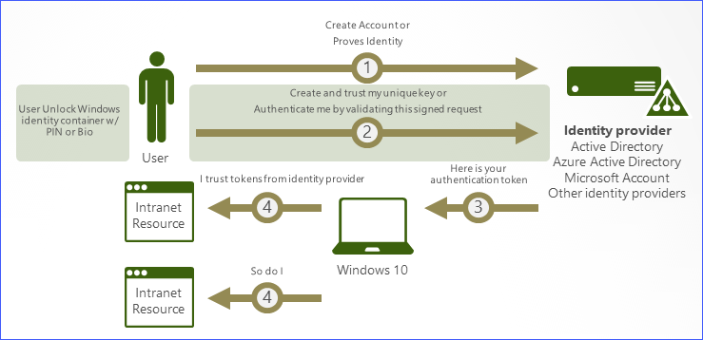
Authentication Flow

Slide 55
User and device registration
A goal of device registration is to allow a user to open a brand-new device, securely join an organizational network to download and manage organizational data and create a new Windows Hello gesture to secure the device.
The registration process works like this:
The user configures an account on the device
can be a local account on the device, a domain account stored in the on-premises Active Directory domain, a Microsoft account, or an Azure AD account.
To sign in using that account, the user must enter the existing credentials for it.
The identity provider (IDP) that “owns” the account receives the credentials and authenticates the user. This IDP authentication may include the use of an existing second authentication factor, or proof.
When the user has provided the proof to the IDP, the user enables PIN authentication.
The PIN will be associated with this particular credential.

Slide 56
Key generation
When the user has completed authentication process, Windows Hello generates a new public–private key pair on the device. The TPM generates and protects this private key; if the device doesn’t have a TPM, the private key is encrypted and stored in software. This is the authentication key.
The authentication key must be protected by a protector key. It’s associated only with a single gesture; in other words, if a user registers a PIN, a fingerprint, and a face on the same device, each of those gestures will have a unique protector key.
Windows Hello also generates an administrative key that the user or administrator can use to reset credentials

Slide 57
Windows Hello Containers
Windows Hello relies on Containers
Containers are made of
One or more keys (usually 1)
One or more protectors
The key is not usable alone. It must be loaded into the same TPM which created it
Even if loaded correctly, TPM won’t allow using the key unless one or more protectors are unlocked
Each protector has its own unlock mechanism
Container
Key
Protects
PIN Protector
PIN
Recovery Key
Recovery Key Protector
Protects
Device
Companion Device Protector
Protects
Gesture
Biometric Protector
Protects

Slide 58
Type of keys
Containers can contain several types of key material
An authentication key
Always an asymmetric public–private key pair. This key pair is generated during registration. It must be unlocked each time it’s accessed, by using either the user’s PIN or a previously generated biometric gesture.
Virtual smart card keys
Generated when a virtual smart card is generated and stored securely in the container
The IDP key
These keys can be either symmetric or asymmetric, depending on which IDP you use. A single container may contain zero or more IDP keys.
IDP keys are used to sign or encrypt authentication requests or tokens sent from this device to the IDP. IDP keys are typically long-lived but could have a shorter lifetime than the authentication key.

Slide 59
Authentication
When a user wants to access protected key material, the authentication process begins with the user entering a PIN or biometric gesture to unlock the device
The user's PIN unlocks the protector key for the container on the device. When that container is unlocked, applications (and thus the user) can use whatever IDP keys reside inside the container.
These keys are used to sign requests that are sent to the IDP

Slide 60
Example authentication process (Azure Active Directory)
The client sends an empty authentication request to the IDP. (This is merely for the handshake process.)
The IDP returns a challenge, known as a nonce.
The device signs the nonce with the appropriate private key.
The device returns the original nonce, the signed nonce, and the ID of the key used to sign the nonce.
The IDP fetches the public key that the key ID specified, uses it to verify the signature on the nonce, and verifies that the nonce the device returned matches the original.
If all the checks in step 5 succeed, the IDP returns two data items: a symmetric key, which is encrypted with the device’s public key, and a security token, which is encrypted with the symmetric key.
The device uses its private key to decrypt the symmetric key, and then uses that symmetric key to decrypt the token.
The device makes a normal authentication request for the original resource, presenting the token from the IDP as its proof of authentication.

Slide 61
Windows Hello for Business features
Conditional access
Dynamic lock
PIN reset
Privileged credentials
Multifactor Unlock

Slide 62
Conditional Access
Requirements:
Azure Active Directory
Hybrid Windows Hello for Business deployment
With application access management, Azure Active Directory enables you to ensure that only the right people can access your applications.

Slide 63
Dynamic Lock
Requirements:
Windows 10, version 1703
Dynamic lock enables you to configure Windows 10 devices to automatically lock when Bluetooth paired device signal falls below the maximum Received Signal Strength Indicator (RSSI) value.

Slide 64
PIN reset
Hybrid Deployments
Requirements:
Azure Active Directory
Hybrid Windows Hello for Business deployment
Modern Management - Microsoft Intune, or compatible mobile device management (MDM)
Remote reset - Windows 10, version 1703
Reset above Lock - Windows 10, version 1709
The Microsoft PIN reset services enables you to help users who have forgotten their PIN. Using Microsoft Intune or a compatible MDM, you can configure Windows 10 devices to securely use the Microsoft PIN reset service that enables you to remotely push a PIN reset or enables users to reset their forgotten PIN above the lock screen without requiring reenrollment.

Slide 65
Privileged Credentials
Requirements
Hybrid and On-premises Windows Hello for Business deployments
Domain Joined or Hybrid Azure joined devices
Windows 10, version 1709
The privileged credentials scenario enables administrators to perform elevated, administrative functions by enrolling both their non-privileged and privileged credentials on their device.

Slide 66
Multifactor Unlock
Requirements:
Windows Hello for Business deployment (Hybrid or On-premises)
Hybird Azure AD joined (Hybrid deployments)
Domain Joined (on-premises deployments)
Windows 10, version 1709
Bluetooth, Bluetooth capable phone - optional
Windows 10 offers Multifactor device unlock by extending Windows Hello with trusted signals, administrators can configure Windows 10 to request a combination of factors and trusted signals to unlock their devices.

Slide 67
Maintaining compatibility with existing applications
Applications designed to use smartcards can transparently access Windows Hello containers
Windows Hello framework and the Smartcard service simulate a smartcard device for applications
Applications designed to use certificate authentication can use the certificate bound to Hello containers
Windows Hello framework provides a KSP so that certificates and associated keys can be used transparently

Slide 68
High-level architecture
TPM
Cloud Experience Host Application
NgcCtnrSvc
Management Applications
Settings Application
lsass.exe
NgcSvc
popkeysvc
LogonUI/
AuthUI
Application
KSP
User Applications
WbioSvc
Biometric Sensor
Application
FIDO
ScardSvr
Application
Smart
Card

